Slide 1



Lecture Slides
Chapter 1
Introduction to
Mechanical Engineering Design
© 2015 by McGraw-Hill Education. This is proprietary material solely for authorized instructor use. Not authorized for sale or distribution in any manner. This document may not be copied, scanned, duplicated, forwarded, distributed, or posted on a website, in whole or part.

Slide 2
課程簡介
Text Book: Richard G. Budynas and J. Keith Nisbett, Shigley‘s
Mechanical Engineering Design, Tenth Edition in SI
Unit, McGraw Hill 2015東華書局 (新月圖書)。
Evaluation: Homework 10%
Project 15%
Six Exams 75%
Syllabus:
1. Steady Failure
2. Fatigue Failure
3. Mechanical Springs
4. Rolling Contact Bearings
5. Lubrication and Journal Bearings
6. Clutches, Brakes, Couplings, and Flywheels

Slide 3
Planetary Gear Reducer Design Specifications
Design Requirement
Input speed 15,000 rpm
Input torque 25N-m
Output speed 937.5 rpm
Output torque 400 N-m
Dimensions
Diameter < 200 mm
Volume < 4 Liters
Weight < 3 Kg
Targeted for electrical race car application, so needs large acceleration
Use of 4 bolts mounted to a Motor with output power 39.270 KW
Bearing selection: what are the specifications?
Input and output shafts standard size for typical couplings

Slide 4
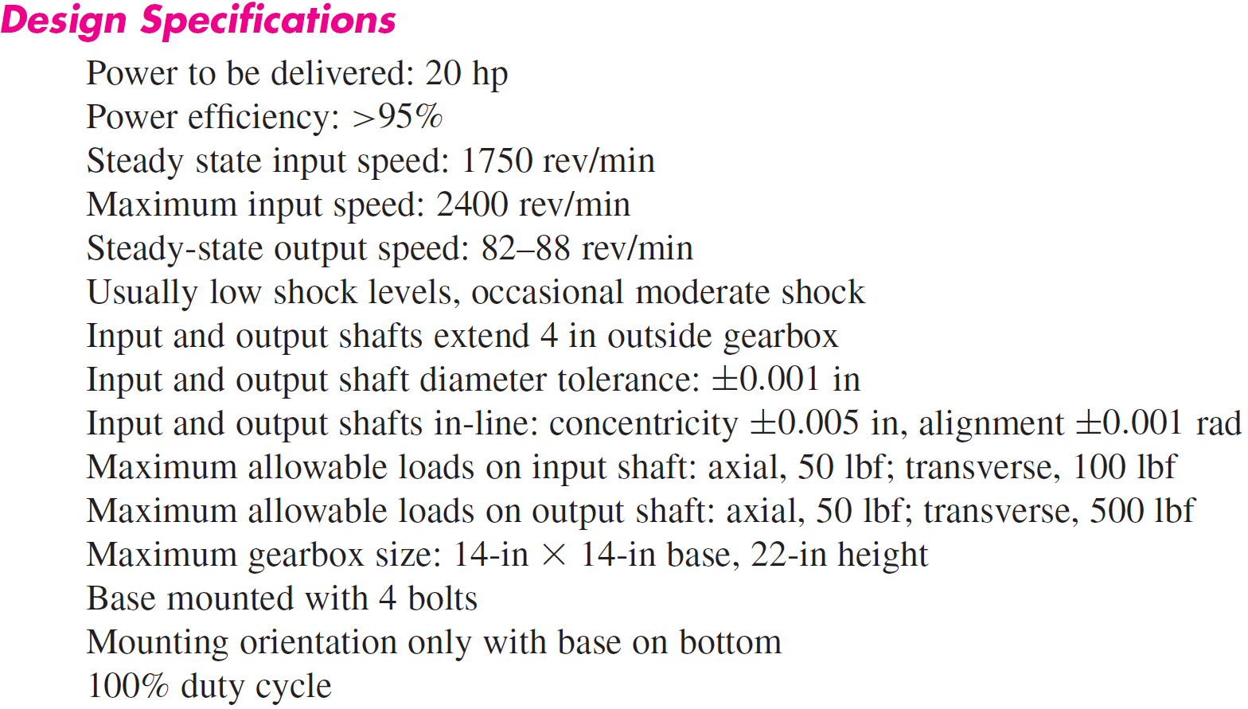
Power Transmission Case Study Specifications

Slide 5

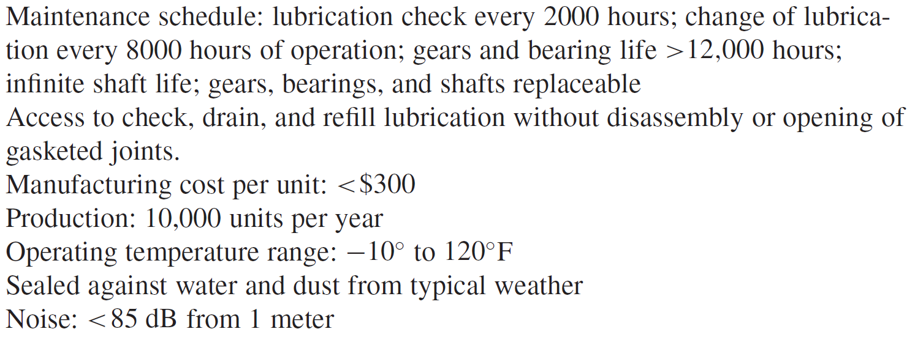
Power Transmission Case Study Specifications

Slide 6
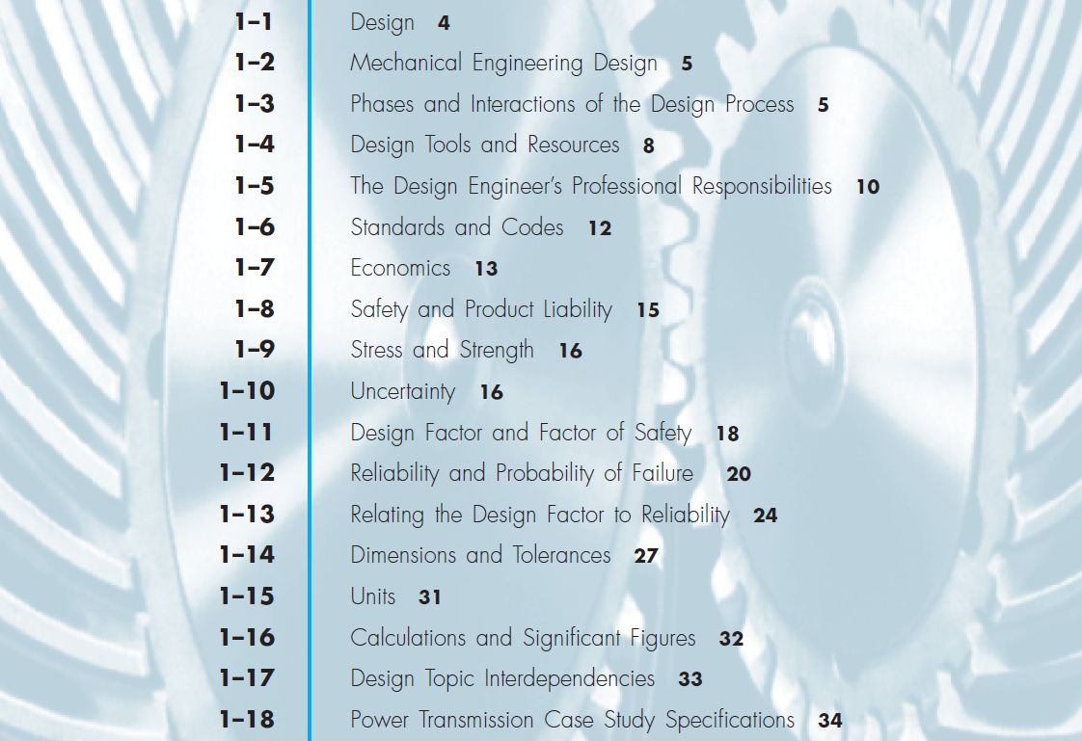
Chapter Outline

Slide 7
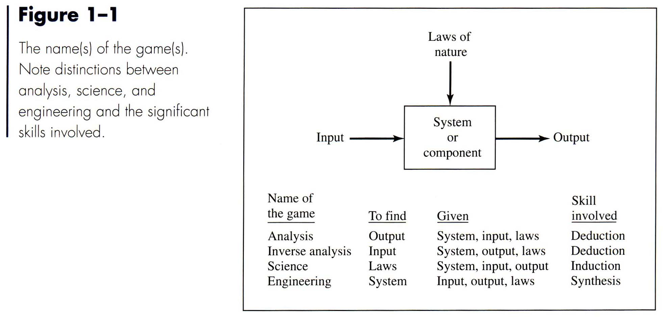
Thermodynamics, Faraday law
Engine, Motor, Transmission
歸納推理 (Inductive Reasoning) : 從觀察一些例子或重複的做同一個實驗所歸納出來的結論。這個結論只是個臆測(Conjecture)，也可能只是從一些(特)例所得到的猜測，所以用歸納推理得到的結論並不保證是對的。
演繹推理 (Deductive Reasoning) : 以一般性的原則、原理推論出(特)定例子的正確性。

Slide 8
Design
To formulate a plan for the satisfaction of a specified need
Process requires innovation, iteration, and decision-making
Communication-intensive
Products should be
Functional
Safe
Reliable
Competitive
Usable
Manufacturable
Marketable

Slide 9
Mechanical Engineering Design
Mechanical engineering design involves all the disciplines of mechanical engineering.
Example
Journal bearing: fluid flow, heat transfer, friction, energy transport, material selection, thermomechanical treatments, statistical descriptions, etc.

Slide 10
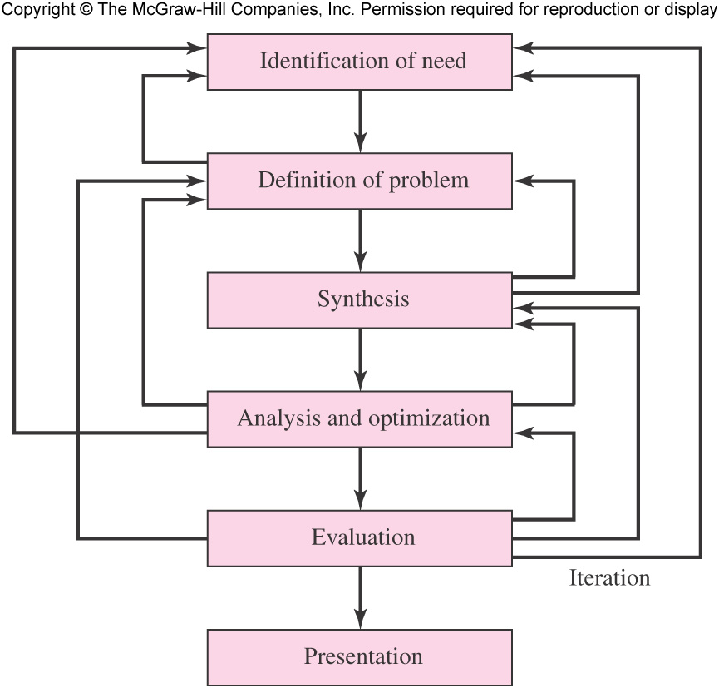
The Design Process
Iterative in nature
Requires initial estimation, followed by continued refinement
Fig. 1–1

Slide 11
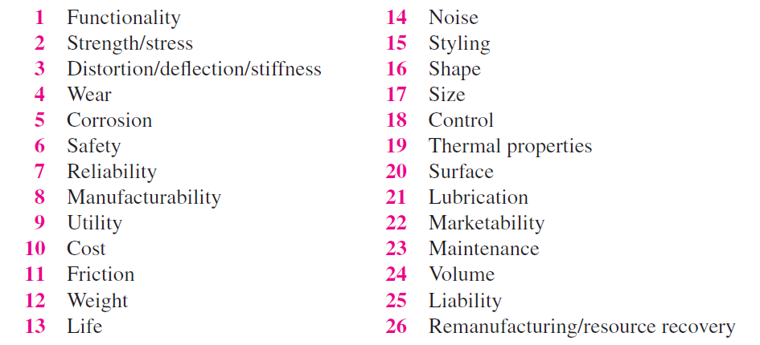
Design Considerations
Some characteristics that influence the design

Slide 12
Computational Tools
Computer-Aided Engineering (CAE)
Any use of the computer and software to aid in the engineering process
Includes
Computer-Aided Design (CAD)
Drafting, 3-D solid modeling, etc.
Computer-Aided Manufacturing (CAM)
CNC toolpath, rapid prototyping, etc.
Engineering analysis and simulation
Finite element, fluid flow, dynamic analysis, motion, etc.
Math solvers
Spreadsheet, procedural programming language, equation solver, etc.

Slide 13
Acquiring Technical Information
Libraries
Engineering handbooks, textbooks, journals, patents, etc.
Government sources
Government agencies, U.S. Patent and Trademark, National Institute for Standards and Technology, etc.
Professional Societies (conferences, publications, etc.)
American Society of Mechanical Engineers, Society of Manufacturing Engineers, Society of Automotive Engineers, etc.
Commercial vendors
Catalogs, technical literature, test data, etc.
Internet
Access to much of the above information

Slide 14
A Few Useful Internet Sites
www.globalspec.com
www.engnetglobal.com
www.efunda.com
www.thomasnet.com
www.uspto.gov

Slide 15
The Design Engineer’s Professional Responsibilities
Satisfy the needs of the customer in a competent, responsible, ethical, and professional manner.
Some key advise for a professional engineer
Be competent
Keep current in field of practice
Keep good documentation
Ensure good and timely communication
Act professionally and ethically

Slide 16
Ethical Guidelines for Professional Practice
National Society of Professional Engineers (NSPE) publishes a Code of Ethics for Engineers and an Engineers’ Creed.
www.nspe.org/ethics
Six Fundamental Canons
Engineers, in the fulfillment of their professional duties, shall:
Hold paramount the safety, health, and welfare of the public.
Perform services only in areas of their competence.
Issue public statements only in an objective and truthful manner.
Act for each employer or client as faithful agents or trustees.
Avoid deceptive acts.
Conduct themselves honorably, responsibly, ethically, and lawfully so as to enhance the honor, reputation, and usefulness of the profession.

Slide 17
NSPE Engineers’ Creed
As a Professional Engineer I dedicate my professional knowledge and skill to the advancement and betterment of human welfare.
I pledge:
To give the utmost of performance;
To participate in none but honest enterprise;
To live and work according to the laws of man and the highest standards of professional conduct;
To place service before profit, the honor and standing of the profession before personal advantage, and the public welfare above all other considerations.
In humility and with need for Divine Guidance, I make this pledge.

Slide 18
Standards and Codes
Standard
A set of specifications for parts, materials, or processes
Intended to achieve uniformity, efficiency, and a specified quality
Limits the multitude of variations
Code
A set of specifications for the analysis, design, manufacture, and construction of something
To achieve a specified degree of safety, efficiency, and performance or quality
Does not imply absolute safety
Various organizations establish and publish standards and codes for common and/or critical industries

Slide 19
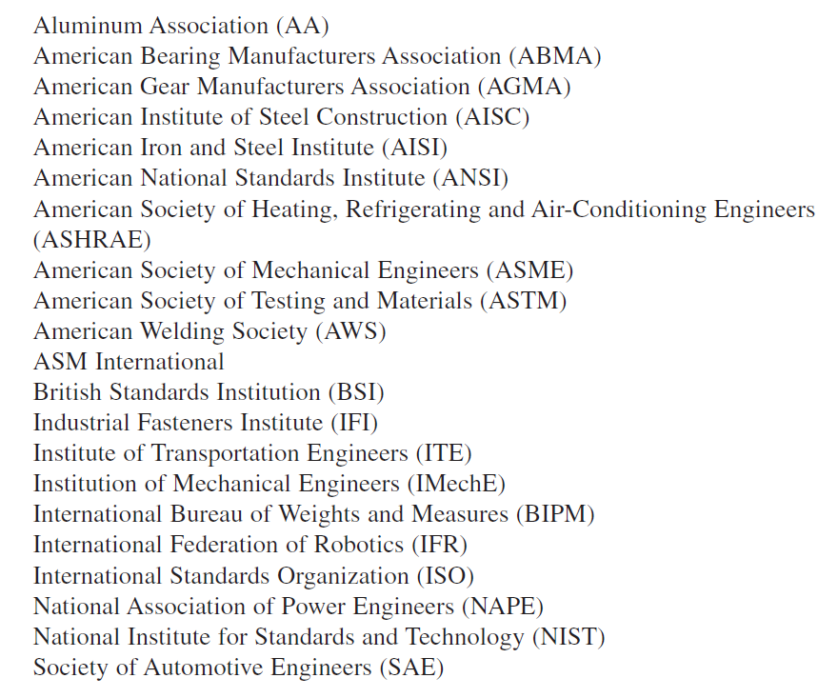
Standards and Codes
Some organizations that establish standards and codes of particular interest to mechanical engineers:

Slide 20
Economics
Cost is almost always an important factor in engineering design.
Use of standard sizes is a first principle of cost reduction.
Table A–17 lists some typical preferred sizes.
Certain common components may be less expensive in stocked sizes.

Slide 21
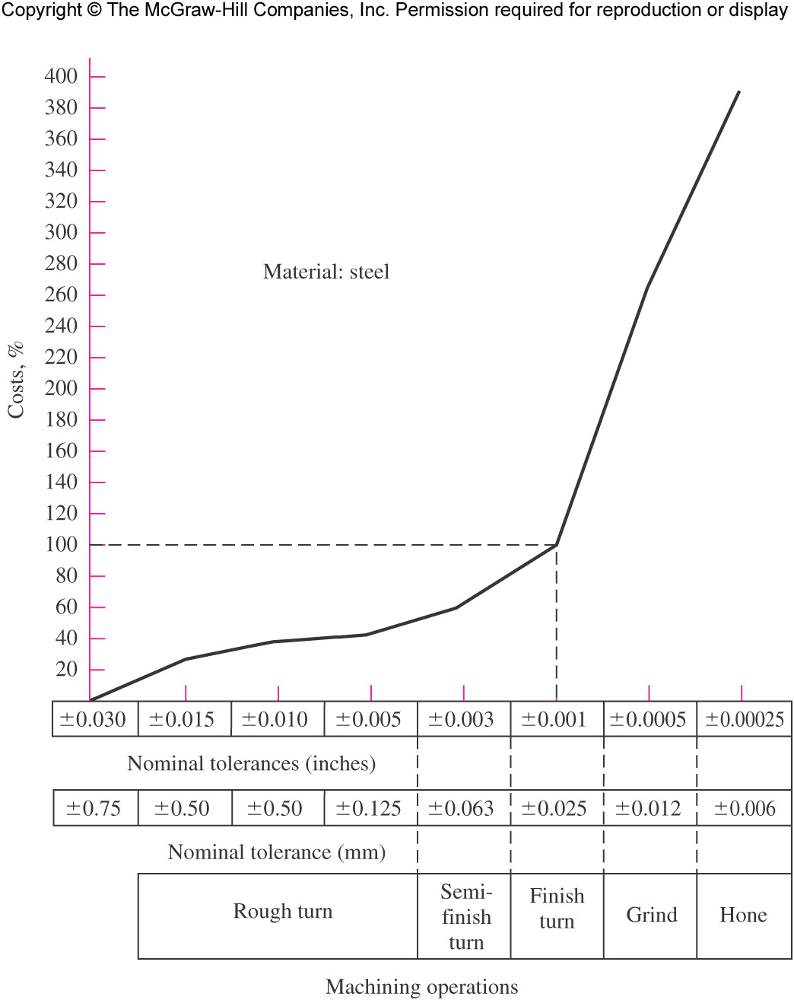
Tolerances
Close tolerances generally increase cost
Require additional processing steps
Require additional inspection
Require machines with lower production rates
Fig. 1–2

Slide 22
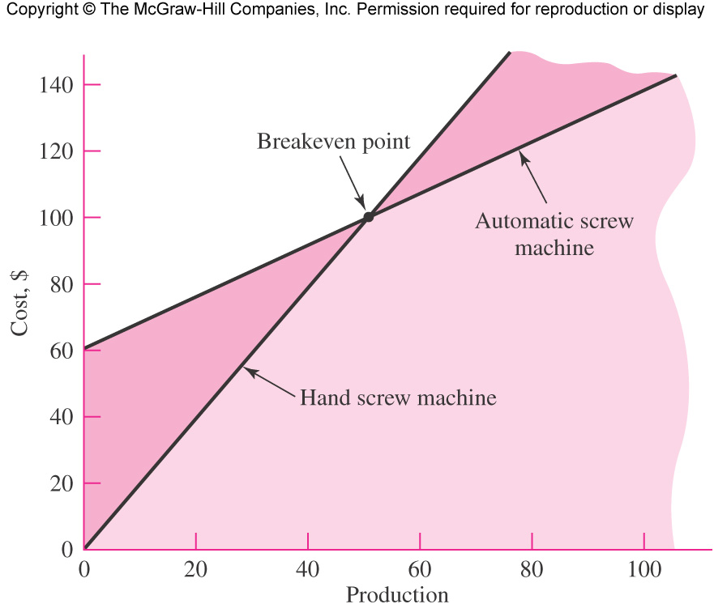
Breakeven Points
A cost comparison between two possible production methods
Often there is a breakeven point on quantity of production
EXAMPLE
Automatic screw machine
25 parts/hr
3 hr setup
$20/hr labor cost
Hand screw machine
10 parts/hr
Minimal setup
$20/hr labor cost
Breakeven at 50 units
Fig. 1–3

Slide 23
Safety and Product Liability
Strict Liability concept generally prevails in U.S.
Manufacturer is liable for damage or harm that results because of a defect.
Negligence need not be proved.
Calls for good engineering in analysis and design, quality control, and comprehensive testing.

Slide 24
Stress and Strength
Strength
An inherent property of a material or of a mechanical element
Depends on treatment and processing
May or may not be uniform throughout the part
Examples: Ultimate strength, yield strength
Stress
A state property at a specific point within a body
Primarily a function of load and geometry
Sometimes also a function of temperature and processing

Slide 25
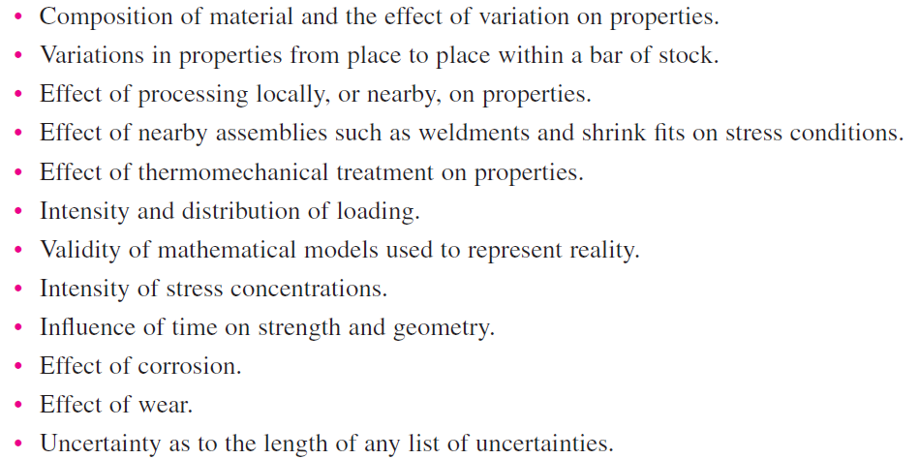
Uncertainty
Common sources of uncertainty in stress or strength

Slide 26
Uncertainty
Stochastic method
Based on statistical nature of the design parameters
Focus on the probability of survival of the design’s function (reliability)
Often limited by availability of statistical data

Slide 27
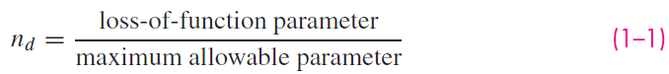
Uncertainty
Deterministic method
Establishes a design factor, n_{d}
Based on absolute uncertainties of a loss-of-function parameter and a maximum allowable parameter
If, for example, the parameter is load, then

Slide 28
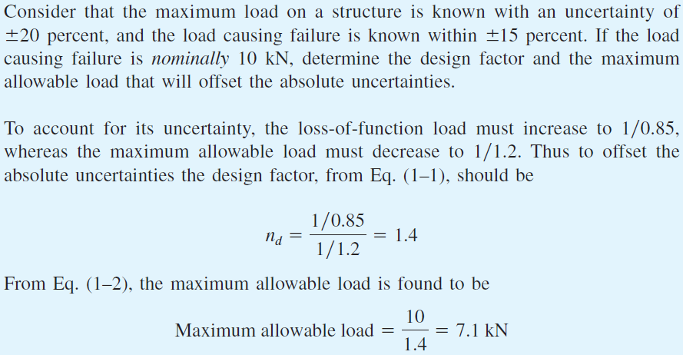
Example 1–1
Solution
Answer
Answer

Slide 29
Design Factor Method
Often used when statistical data is not available
Since stress may not vary linearly with load, it is more common to express the design factor in terms of strength and stress.
All loss-of-function modes must be analyzed, and the mode with the smallest design factor governs.
Stress and strength terms must be of the same type and units.
Stress and strength must apply to the same critical location in the part.
The factor of safety is the realized design factor of the final design, including rounding up to standard size or available components.

Slide 30
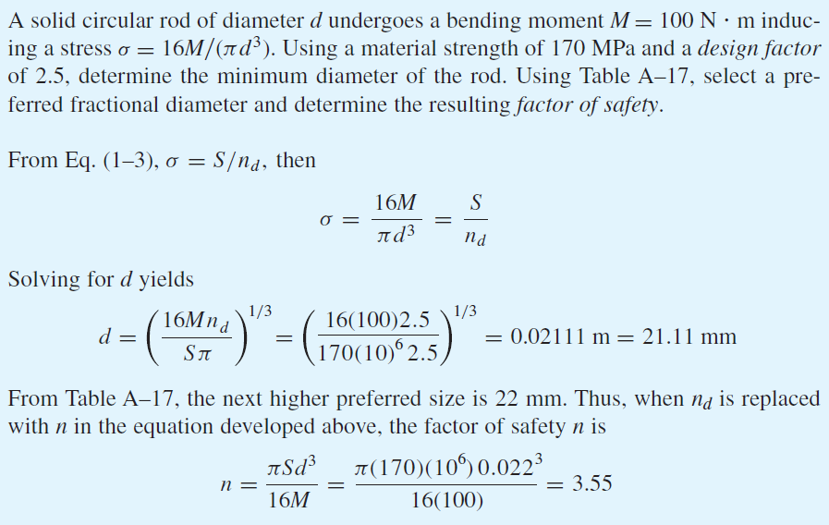
Example 1–2
Solution
Answer
Answer

Slide 31
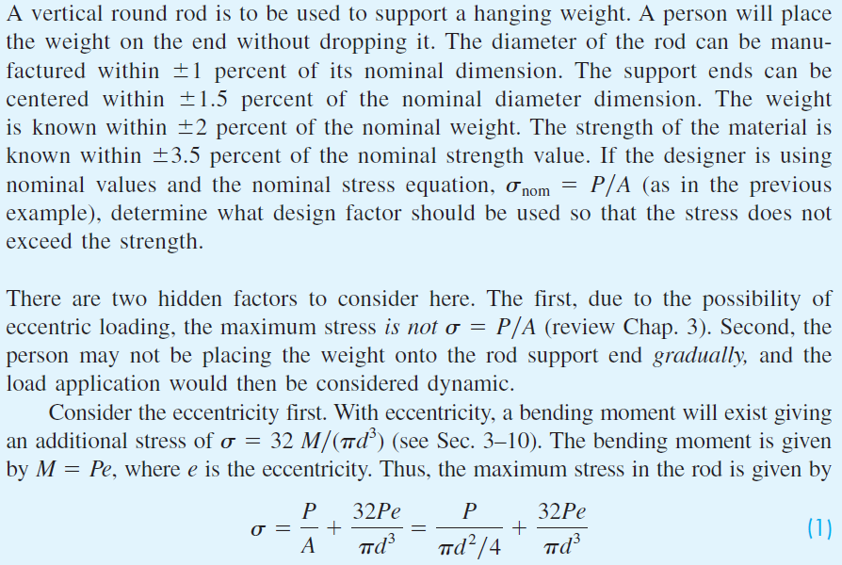
Example 1–3
Solution

Slide 32
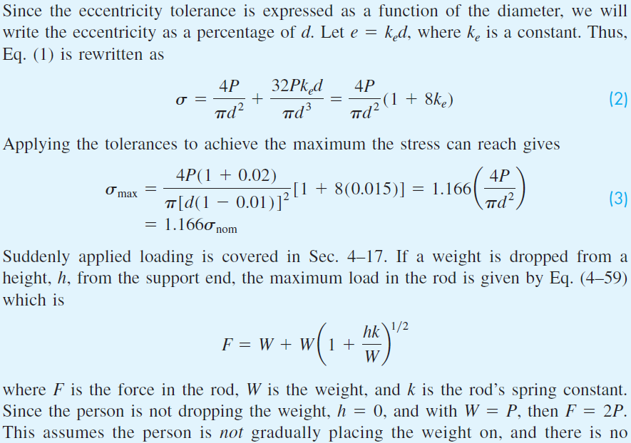
Example 1–3 (continued)

Slide 33
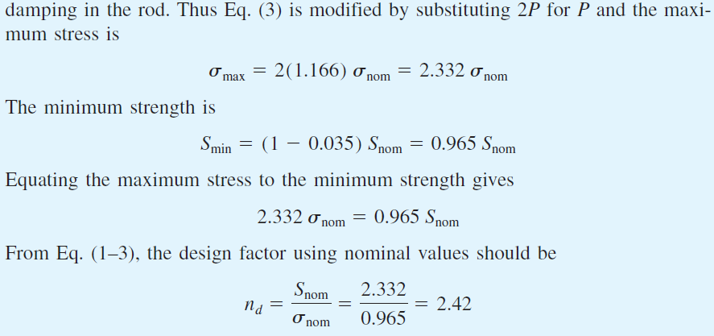
Example 1–3 (continued)
Answer

Slide 34
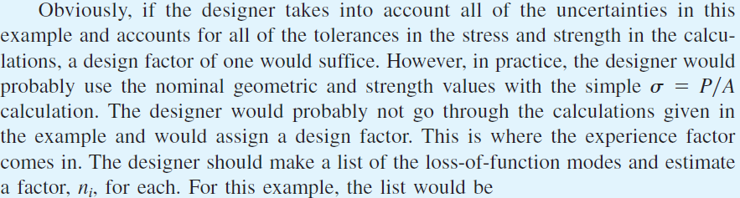
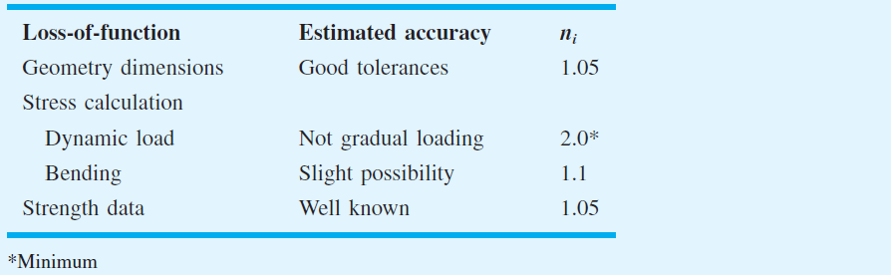
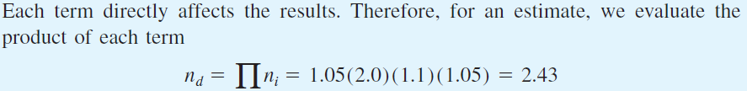
Example 1–3 (continued)

Slide 35
Reliability Method of Design
Reliability method of design – A method of design that relates the distribution of stresses with the distribution of strengths to achieve an acceptable success rate.
Reliability, R – The statistical measure of the probability that a mechanical element will not fail in use

Slide 36
Probability of Failure
Probability of Failure, p_{f} – the number of instances of failures per total number of possible instances
Probability Density Function, PDF – the distribution of events within a given range of values.
Two common PDFs
Gaussian (normal) distribution
Weibull distribution

Slide 37
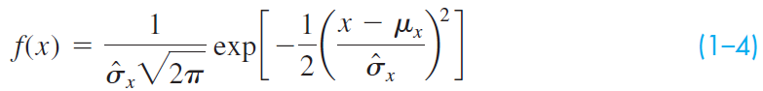
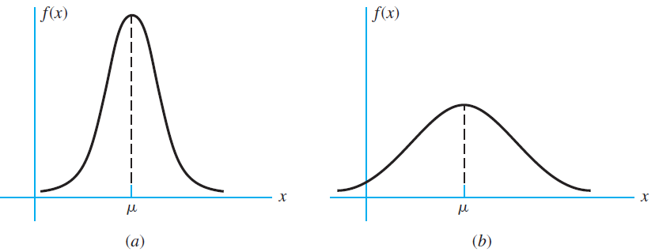
Gaussian (Normal) Distribution
The probability density function (PDF) of the Gaussian distribution is expressed in terms of its mean, μ_{x}, and its standard deviation
large
small
Fig. 1–4 Typical plots of the Gaussian distribution

Slide 38
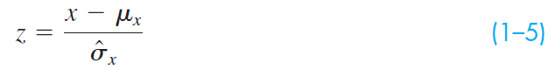
Gaussian (Normal) Distribution
p_{f} is obtained by integrating Eq. (1–4).
The variable x is placed in dimensionless form using the transformation variate
The transformation variate is normally distributed, with a mean of zero and a standard deviation and variance of unity.

Slide 39
Cumulative Distribution Function for Gaussian Distribution
Integration of the Gaussian distribution to find the cumulative density function F(x) is accomplished numerically.
To avoid the need for many tables for different values of mean and standard deviation, the z transform is used.
The integral of the transform is tabulated in Table A–10.

Slide 40
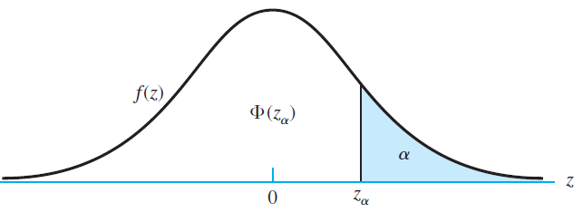
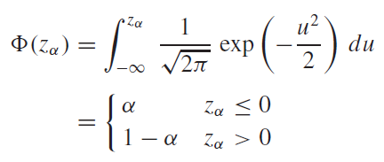
Cumulative Distribution Function for Gaussian Distribution
A sketch of the standard normal distribution, showing the z transform is given below.
The normal cumulative density function is labeled Φ(z_{α})
Fig. 1–5

Slide 41
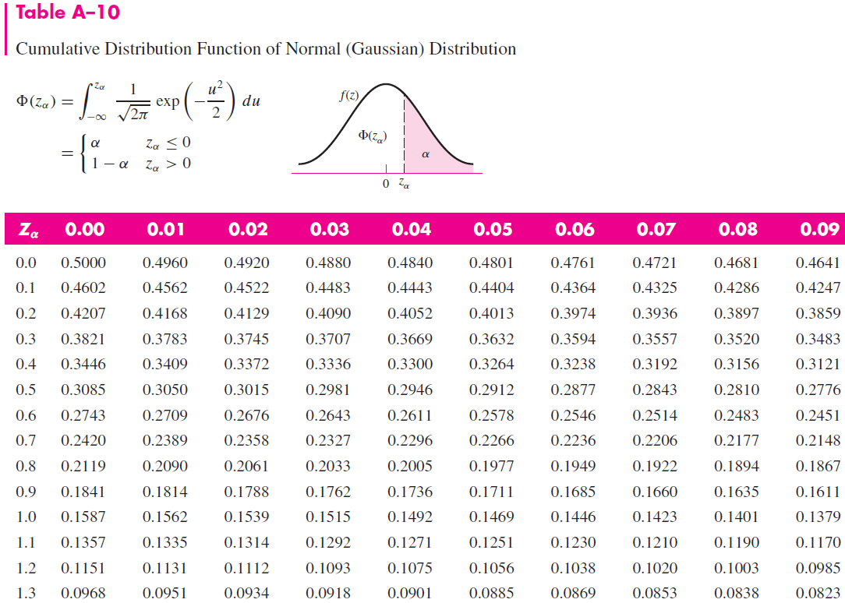
(partial)

Slide 42
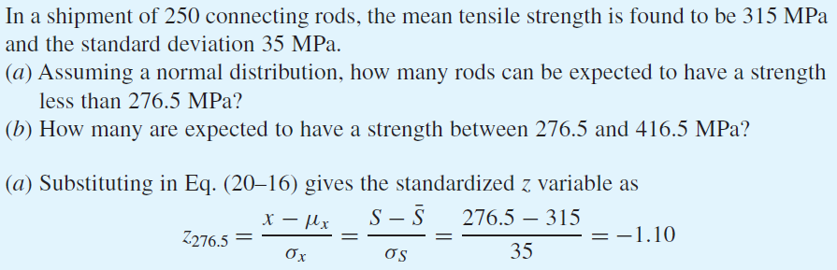
Example 1–4
Solution

Slide 43
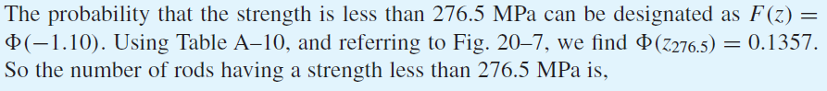
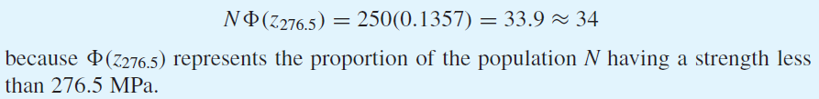
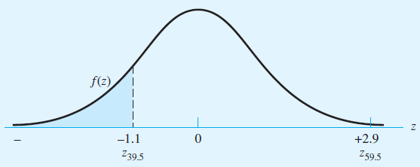
Example 1–4 (continued)
Answer
Fig. 1–6

Slide 44
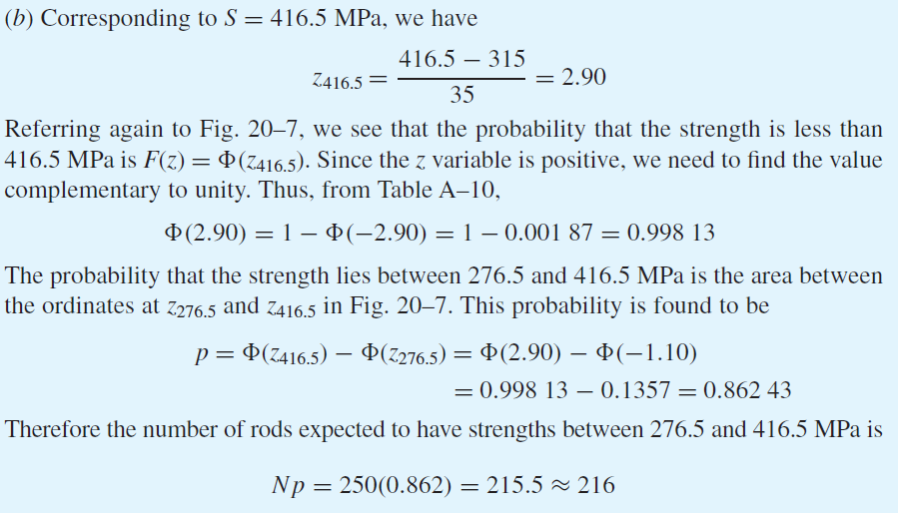
Example 1–4 (continued)
Answer

Slide 45
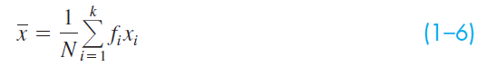
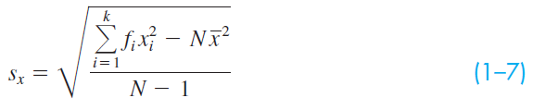
Discrete Mean and Standard Deviation
x_{i} is the value of an event (i = 1, 2, … k)
f_{i} is the class frequency, or number of times the event x_{i} occurs within the class frequency range
The discrete mean is
The discrete standard deviation is

Slide 46
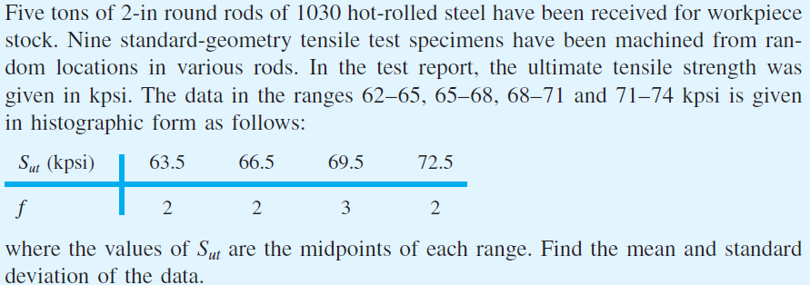
Example 1–5

Slide 47
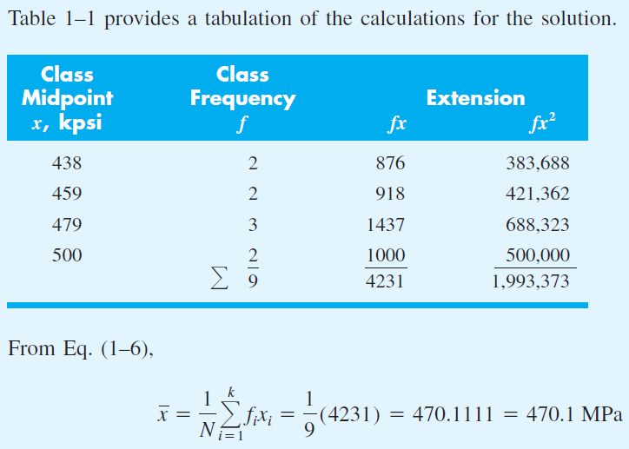
Example 1–5 (continued)
Solution
Table 1–1
Answer

Slide 48
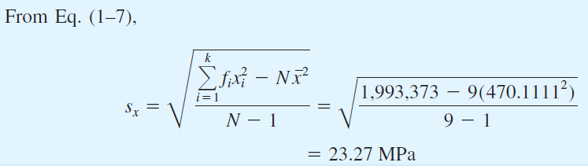
Example 1–5 (continued)
Answer

Slide 49
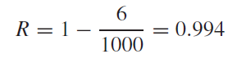
Reliability
The reliability is related to the probability of failure by
Example: If 1000 parts are manufactured, with 6 of the parts failing, the reliability is
or 99.4 %

Slide 50
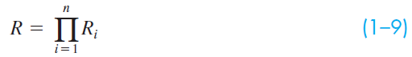
Reliability
Series System – a system that is deemed to have failed if any component within the system fails
The overall reliability of a series system is the product of the reliabilities of the individual components.
Example: A shaft with two bearings having reliabilities of 95% and 98% has an overall reliability of
R = R₁ R₂ = 0.95 (0.98) = 0.93 or 93%

Slide 51
Relating Design Factor to Reliability
Reliability is the statistical probability that machine systems and components will perform their intended function satisfactorily without failure.
Deterministic relations between stress, strength, and design factor are often used due to simplicity and difficulty in acquiring statistical data.
Stress and strength are actually statistical in nature.

Slide 52
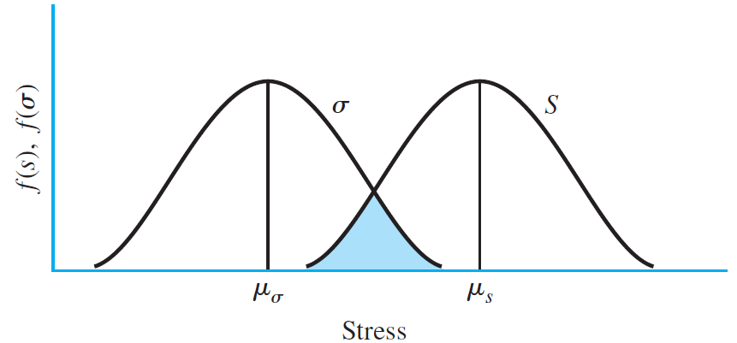
Probability Density Functions
Stress and strength are statistical in nature
Plots of probability density functions shows distributions
Overlap is called interference of σ and S, and indicates parts expected to fail
Fig. 1–7 (a)

Slide 53
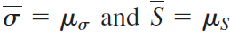
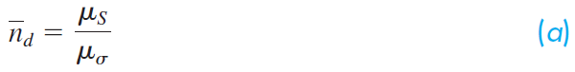
Probability Density Functions
Mean values of stress and strength are
“Average” design factor is
Margin of safety for any value of stress σ and strength S is
The overlap area has negative margin of safety
Fig. 1–7(a)

Slide 54
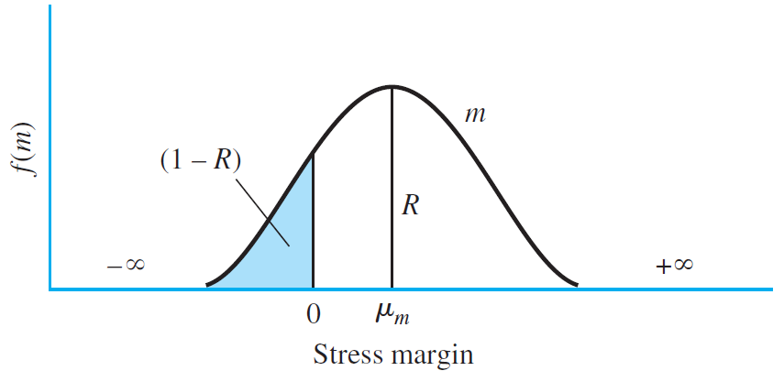
Margin of Safety
Distribution of margin of safety is dependent on distributions of stress and strength
Reliability R is area under the margin of safety curve for m > 0
Interference is the area 1–R where parts are expected to fail
Fig. 1–7 (b)

Slide 55
Normal-Normal Case
Common for stress and strength to have normal distributions
Margin of safety is m = S – σ, and will be normally distributed
Reliability is probability p that m > 0. That is,
To find probability that m > 0, form the transformation variable of m and substitute m=0

Slide 56
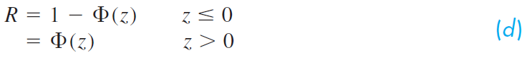
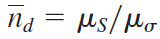
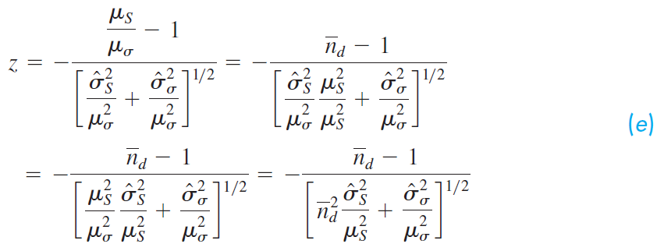
Normal-Normal Case
Comparing Fig. 1–7b with Table A–10, we see that
To relate to the design factor, , divide each term on the right side of Eq. (1–10) by μ_{σ} and rearrange:

Slide 57
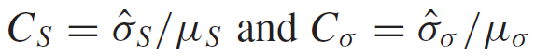
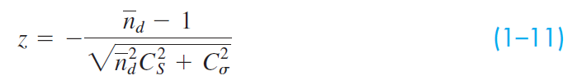
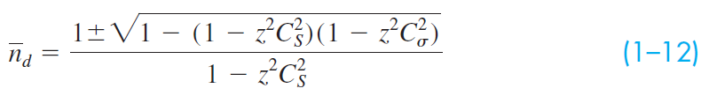
Normal-Normal Case
Define coefficients of variance for strength and stress
Rewrite Eq. (e),
Squaring and solving for the design factor,
The plus sign is for R > 0.5, and the minus sign for R ≤ 0.5

Slide 58
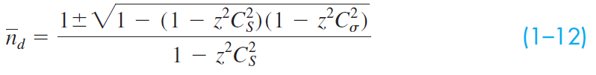
Relating Design Factor to Reliability
In summary, Eq. (1–12) relates the design factor to the reliability goal (through the transform variate) and the coefficients of variation of strength and stress.

Slide 59
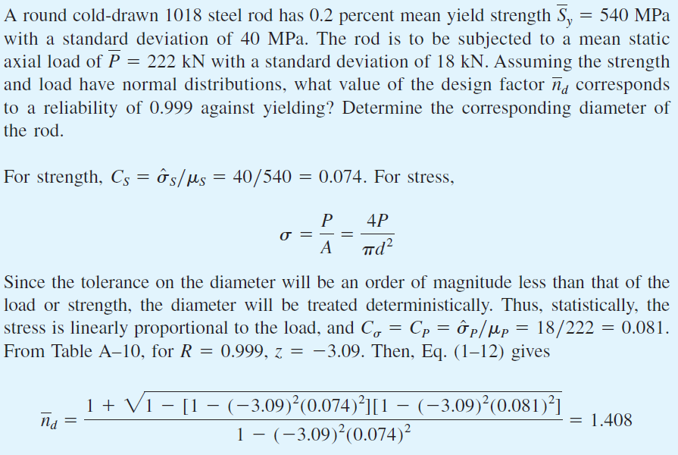
Example 1–6
Solution
Answer

Slide 60
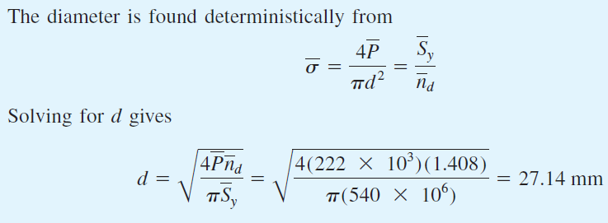
Example 1–6 (continued)
Answer

Slide 61


Dimensions and Tolerances
Nominal size – The size we use in speaking of an element.
Is not required to match the actual dimension
Limits – The stated maximum and minimum dimensions
Tolerance – The difference between the two limits
Bilateral tolerance – The variation in both directions from the basic dimension, e.g. 1.005 ± 0.002 in.
Unilateral tolerance – The basic dimension is taken as one of the limits, and variation is permitted in only one direction, e.g.

Slide 62
Dimensions and Tolerances
Clearance – Refers to the difference in sizes of two mating cylindrical parts such as a bolt and a hole.
Assumes the internal member is smaller than the external member
Diametral clearance – difference in the two diameters
Radial clearance – difference in the two radii
Interference – The opposite of clearance, when the internal member is larger than the external member
Allowance – The minimum stated clearance or the maximum stated interference or mating parts
Fit – The amount of clearance or interference between mating parts
GD&T – Geometric Dimensioning and Tolerancing, a comprehensive system of symbols, rules, and definitions for defining the theoretically perfect geometry, along with the allowable variation.

Slide 63
Choice of Tolerances
The designer is responsible for specifying tolerances for every dimension.
Consideration is given to functionality, fit, assembly, manufacturing process ability, quality control, and cost.
Excessive precision is a poor design choice, in that it limits manufacturing options and drives up the cost.
Less expensive manufacturing options should be selected, even though the part may be less than perfect, so long as the needs are satisfactorily met.

Slide 64

Choice of Dimensions
Dimensioning a part is the designer’s responsibility.
Include just enough dimensions
Avoid extraneous information that can lead to confusion or multiple interpretations.
Example of over-specified dimensions. With +/– 1 tolerances, two dimensions are incompatible.
Fig. 1–8

Slide 65

Choice of Dimensions
Four examples of which dimensions to specify
Fig. 1–9

Slide 66


Tolerance Stack-up
The cumulative effect of individual tolerances must be allowed to accumulate somewhere. This is known as tolerance stack-up.
Chain dimensioning allows large stack-up of many small tolerances in series.
Baseline dimensioning minimizes large tolerance stack-up.

Slide 67

Example 1–7
Fig. 1–10

Slide 68

Example 1–7 (Continued)
Solution
Answer
Answer
Answer

Slide 69

Linked End-Of-Chapter Problems

